Slide 1

2020: Survival
Team Members:
Karishma Garikapalli
Vamsidhar Reddy Poothi
Nikhila Ratakonda
Rohith Reddy Anugu

Slide 2
Abstract
The main idea of the game is to navigate through multiple levels of this game without catching COVID virus. A player enters each level outside of a building, with a mask on and fully sanitized. Once the game starts, the player has to navigate through a map to reach entrance of another building. As the player progresses through the level, they have to dodge various particles of viruses in the air (whose occurrence depends on how populous the environment is). In case they encounter a virus once, they lose their mask. When they encounter the virus again, they lose health points and eventually get infected (loose the game). The player can find sanitizer stations and masks along the way at a few places to restock and replenish their health. The end goal is for the player to reach the finish point with a mask on and with a threshold health level.

Slide 3
Game Rules
Objective of the player is to reach FINISH, from START, of the level with a mask on and threshold health
If the player loses health completely, game is lost
Player is presented with a map in very level and has to choose a path to navigate through
Every path has direction arrows to point the way for the player
Sanitizer restores some health for the player by killing virus they come in contact with
Masks help players not get infected, they disappear when in contact with virus
Players can find Mask stands and Sanitizer stations along their path
Players may encounter other people along the way
They occurrence of other people will cause more virus particles to appear in the vicinity
Other people may be masked or unmasked, the appearance of the virus particles around them increases when they are unmasked

Slide 4
Start Screen
This screen has options the players can select to do the following:
Start the Game
Resume the Game
Exit/Quit the Game
View Score
View Rules/Instructions
Sound Settings

Slide 5
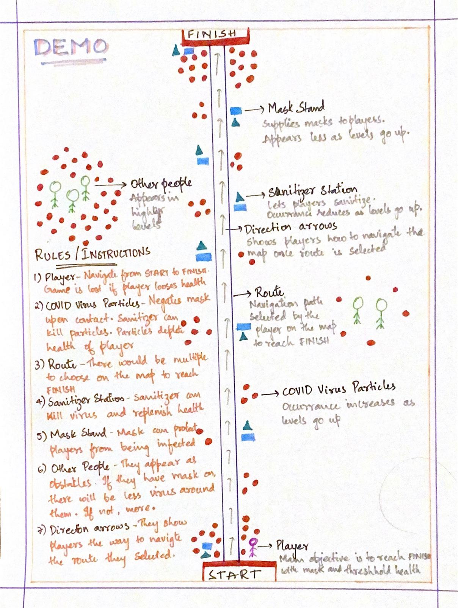
Demo

Slide 6
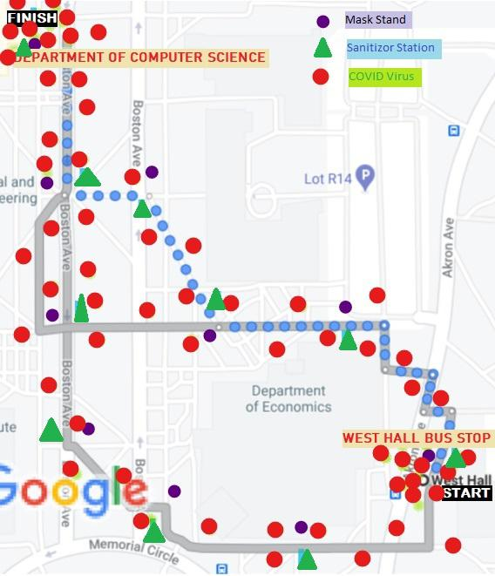
Beginner Level

Slide 7
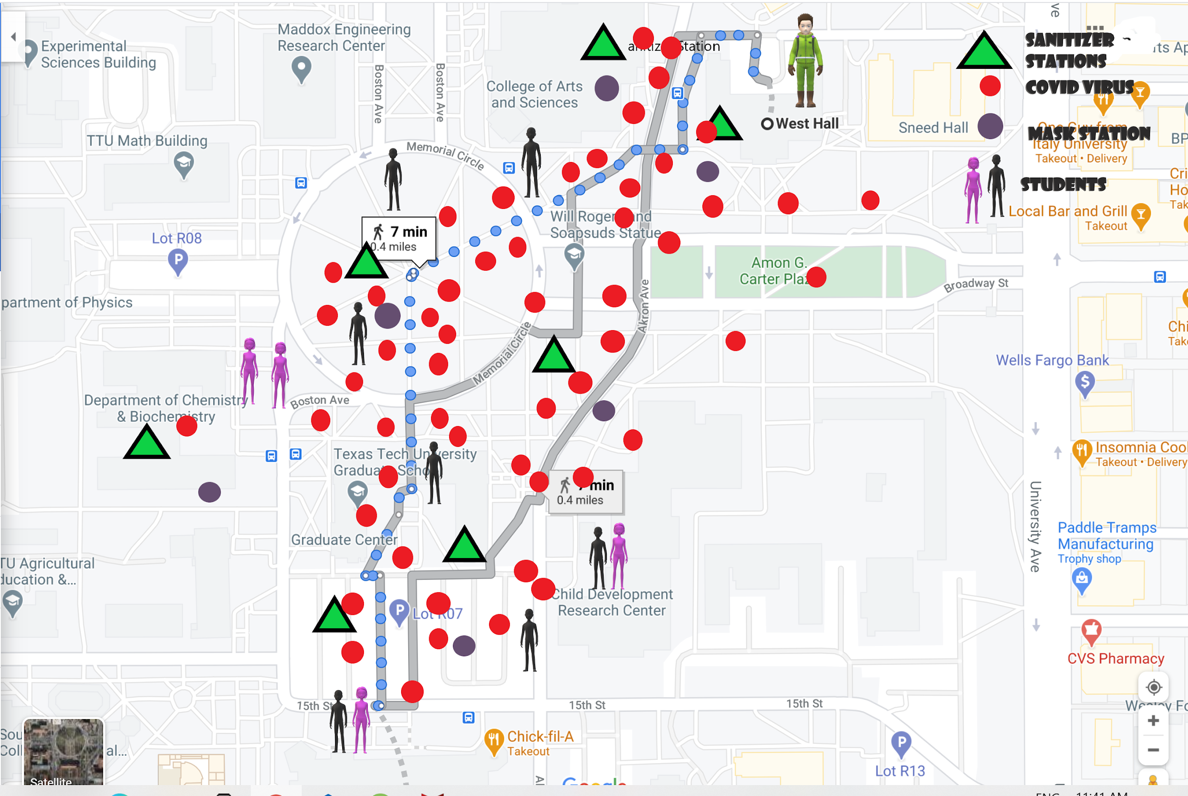
Intermediate Level

Slide 8
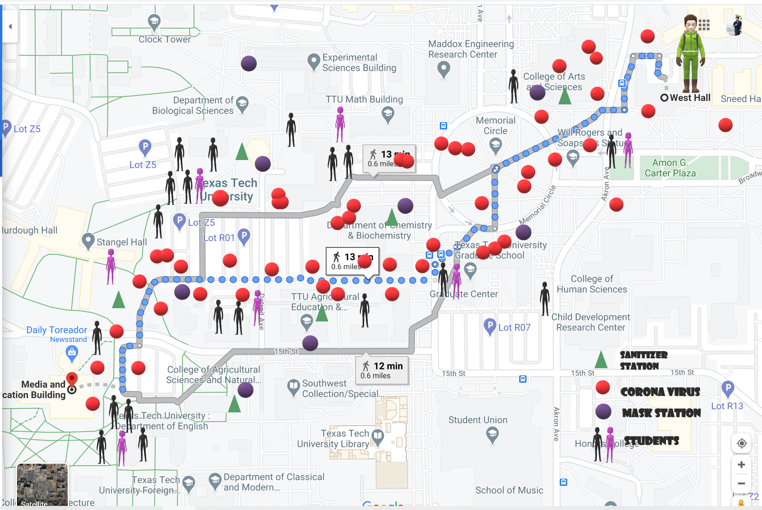
Expert Level

Slide 9
Roles of Team Members
These are temporary assignments, that could change as we progress

Slide 10
Karishma Garikapalli
Abstract
Game Rules
Design and Sketch of Demo
Implementation of Expert Level

Slide 11
Vamsidhar Reddy Poothi
Game Rules
Design and Sketch of Beginner Level
Implementation of Demo
User Interface

Slide 12
Nikhila Ratakonda
Game Rules
Design and Sketch of Expert Level
Implementation of Beginner Level

Slide 13
Rohith Reddy Anugu
Game Rules
Design and Sketch of Intermediate Level
Implementation of Intermediate Level

Slide 14
Any Question?

